Slide 1
SGS Cloud Enablement (Tier0)
Office Hours

Slide 2
1
Overview of Tier0
Agenda
2
Tier0 Services (Features)
3
Onboarding and Integration with Tier0 Services
4
  Support Processes
5
Q&A

Slide 3







SGS Cloud Overview
Build MARS-E/NIST/FedRAMP compliant Azure platform with foundational services, migration of on-prem workloads to cloud, perform R&D and innovate solutions, and manage cloud ops.
Deployed Capabilities
AR
Currently live.
AR
MA
NC
HI
Customers
MA
MA-LTSS is in build phase. Go-Live Oct ’24.
Centralized Logging
NC
Supporting 6+ Non-prod env. Go Live Sep ’26.
Perimeter Protection
HI
Non-Prod subscription created. Go-Live Feb ’25.
AL
Tenant creation is in progress.
Sentinel Security Alert
SGS Cloud
Tier0
Product/Platform
AEP
HCEP
Provider
Compliance & Security Policy
Tier0 Managed Azure Kubernetes Service
Achievements
Automation everywhere
EIS endorsement
Perimeter protection
OpenIAM
50% cost saving with OMMS Product on SGS Cloud
Email
Patent In-Progress
Managed File Transfer
Autonomous Policy Validation framework
Cincom - POC
Available on SGS and OCC Azure Tenants to address different use cases.

Slide 4
SGS Cloud Roadmap
Q1 2024
Q2 2024
Q3 2024
Q4 2024
Jan
Feb
Mar
Apr
May
June
Jul
Aug
Sep
Oct
Nov
Dec
Cincom - POC
MFT
Email
CAKS
OpenIAM
ITSM (JSM)
Monitoring and Dashboard (Grafana)
Tier0 HA&DR
Certificate Renewal
Egress
MARS-E Audit Remediation
Release Management
MARS-E Audit Remediation
Completed
In Progress
Not yet started
NOTE: Timelines are subject to change as the priority evolves

Slide 5




Centralized Logging (Launchpad)
Objective
Benefits to Application Team
Initial Setup
Responsibilities
To store all cloud resources and application logs at a centralized location.
Retention of logs as per the applicable compliance policies.
Taken care as part of application team onboarding process.
Tier0
Logs are stored centrally to meet security and compliance.
Automatic log collection (except application logs).
All types of logs collected e.g., Audit, Activity, AAD, VM etc.
Provisioning the subscription to ensure logs are collected automatically (except Application logs).
Fix any issues, if logs are not collected.
Retain the logs as per the applicable compliance policies.
Application Team
Integration of application logs with Tier0
Notes:
- No action required from application team for log collection
- Next step in logging is to create dashboards

Slide 6
Perimeter Protection (Ingress)
Objective
Benefits to Application Team
Initial Setup
Responsibilities
Single entry/exit point for SGS applications residing within private network.
Scalable & secure solution with multi-tenant capability
Application team needs to raise a service now ticket with ingress intake form.
Tier0 applies the necessary changes.
Application team need to perform complete testing
Application team needs to fix any URL getting blocked by firewall.
Application team provides the confirmation of testing in the ticket.
Tier0 closes the ticket.
Tier0
Simple and Cost effective
Global delivery scale using Microsoft's global CDN – Front Door.
Accelerated application performance
Highly secure with 250 + WAF rules.
Create required services & infrastructure and keep it up & running.
Application Team
Keep the same domain name in ingress intake form & application team AKS.
Certificate maintenance
Contact Tier0 in case of error occurs with error code 403 by raising SN ticket

Slide 7
Perimeter Protection (Egress)
Objective
Benefits to Application Team
Initial Setup
Responsibilities
Single entry/exit point for SGS applications residing within private network.
Scalable & secure solution with multi-tenant capability
Application team needs to raise a service now ticket with egress intake form.
CloudOps applies the necessary firewall rules.
Application team need to perform complete testing
Application team needs to avoid any internet access unless it’s approved.
Application team provides the confirmation of testing in the ticket.
CloudOps closes the ticket.
CloudOps/Tier0
Centralized Solution for Outbound Security.
Better security as firewall blocks all outgoing traffic except whitelisted hostnames.
Advanced Threat Intelligence and Intrusion Detection features available.
All IP addresses are NATed for abstraction.
Create required services & infrastructure and keep it up & running.
Application Team
Identify all hostname(s)/url(s) which needs to be accessed from virtual network.
Use private access to Azure PAAS services.
Contact CloudOps in case of error occurs with error code 403 by raising SN ticket.

Slide 8
Policy
Objective
Benefits to Application Team
Initial Setup
Responsibilities
The policies help enforce adherence to the applicable security and compliance standards.
Taken care as part of application team onboarding process.
Tier0
Subscription provisioned with applicable security and compliance policies.
Managed by Tier0.
Real time enforcement of policies & evaluation.
System generated alerts for non-complaint and vulnerable resources.
To fix all the non-compliant Tier0 resources
Notification email with the list of policies which are non-complaint on application’s resources
Application Team
To fix all the non-compliant application’s resources

Slide 9
Security/Health Alerts (Sentinel)
Objective
Benefits to Application Team
Initial Setup
Responsibilities
Security Information Event Management (SIEM) solution powered by Microsoft Sentinel
Taken care as part of application’s onboarding process.
Tier0
200+ MS Sentinel alerts
Health alerts for All types of resources already configured.
The configured alert should trigger as expected.
The alert email should be sent to application team’s email address.
Application Team
Appropriate action to be taken based on alerts.

Slide 10
OpenIAM
Objective
Benefits to Application Team
Initial Setup
Responsibilities
A multitenant single Open IAM instance to provide managed identity solution to multiple applications.
Instance will be created by Tier0.
Organizations will be created by Tier0.
Tier0
Cost saving as infrastructure is shared.
Managed service
Making sure instance is up and running.
Resolving stability issues.
Deployment of application specific customizations e.g., css file.
Application Team
Configuring and customizing the OpenIAM as per the application’s requirement.

Slide 11
Tier0 Managed CAKS
Objective
Benefits to Application Team
Initial Setup
Responsibilities
A single centralized Azure Kubernetes Instance to provide a platform to multiple application teams to host their applications.
Instance will be created by Tier0.
Namespaces and Role bindings will be managed by Tier0.
Perimeter Protection (AGIC) will be created by Tier0 after ticket (Perimeter Protection) submission by application team.
Application logs will be configured by Tier0.
Tier0
As upgrade & maintenance will be done by Tier0 team, application team only need to handle the deployments.
Shared infrastructure for cost saving.
Enhanced Security Controls as managed by Tier0.
Integrated with Tier0 capability (CL, Perimeter Protection) that provides end-to-end solution.
Managed upstream and downstream services like storage etc.
Namespace level granular access to AKS.
Namespace Creation.
Manage role bindings.
Perimeter Protection (AGIC) Installation.
Application Log (Fluentd) installation.
Storage Class Setup.
AKS Version upgrade.
Application Team
Application deployment like Pods, Services, secrets Ingresses, Configmaps, etc.

Slide 12
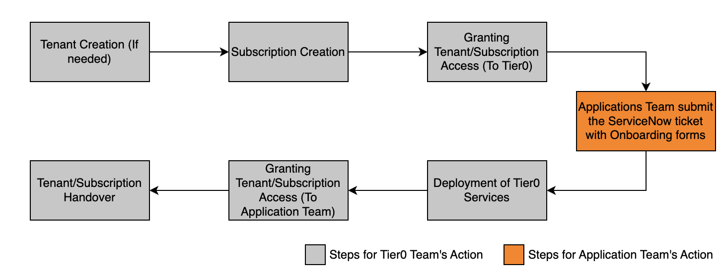
Application Team Onboarding (Tier0 Provisioning)
Timelines
SLA for tenant and subscription creation (including approvals) | 3-4 weeks
SLA for Tier0 Provisioning | 2-3 Weeks
Flow Explanation
Tenant Creation (If needed) – The tenant will be created as per the requirement after application team provides the prerequisite information.
Subscription Creation – The subscription will be created by Tier0 team using the information provided by application team in previous step.
Granting Access (To Tier0) – The Tier0 Support team will need access to the subscriptions for setting up the configuration files.
Application team submit the ticket and form – Once the application team is ready with all the details of subscription, they need to fill the onboarding form with required details and create a Service Now ticket to submit that form.
Deployment of Tier0 Services – Tier0 team will deploy the components for the provisioning of features.
Granting Access (To Application Team) – Once application team receives access to the subscriptions, they need to validate their access and perform testing on the provisioned features.
Tenant/Subscription Handover – After successful closure of service now ticket, the subscription will be handed over to the application team.

Slide 13
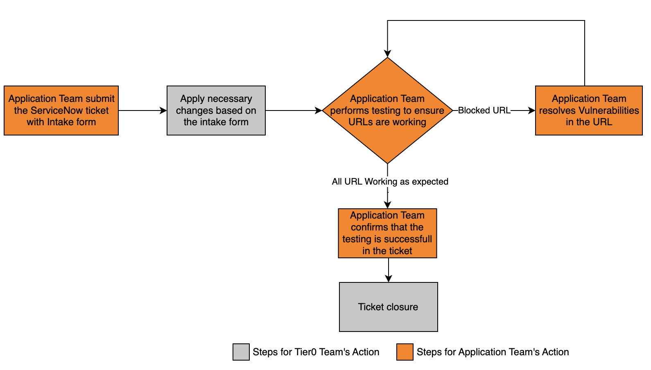
Perimeter Protection (Ingress) Intake
Timelines
SLA for Tier0 to execute the ingress onboarding activities including Domain registration (excluding application team’s testing and vulnerability fixing) | 2-3 weeks
Flow Explanation
Raise a ServiceNow ticket with Ingress Intake Form. Separate ticket is needed for each environment.
Tier0 team will apply the necessary changes based on the intake form.
Application team needs to perform complete testing to ensure that all URLs are working.
If any URL gets blocked, application team needs to fix the vulnerabilities in the URL.
Once the application team provides positive confirmation over ticket for the testing, the ticket will be closed.
Recommendation
To minimize the impact in ongoing activities, initial onboarding should be done in the least used environment.

Slide 14
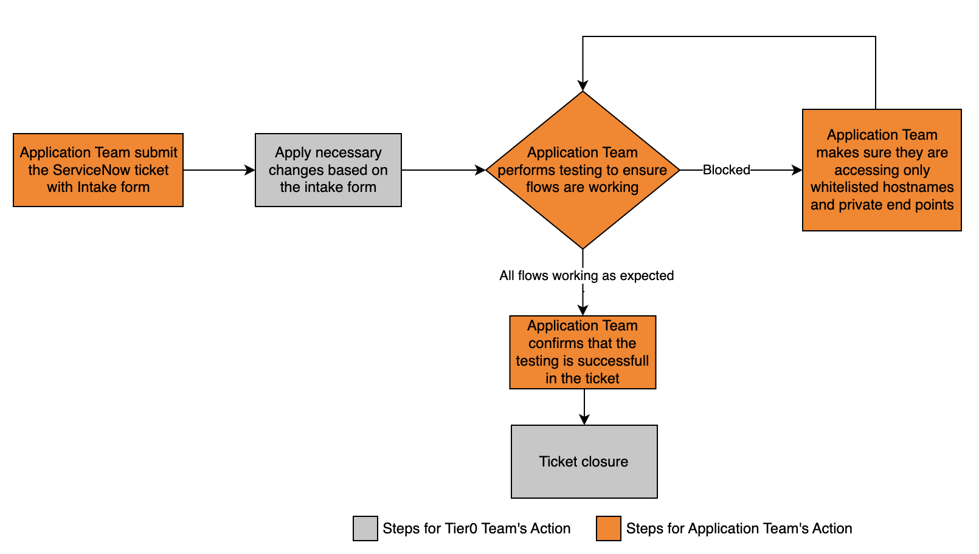
Perimeter Protection (Egress) Intake
Timelines
SLA for CloudOps to execute the egress onboarding activities (excluding application team’s testing and issue fixing) | 2-3 weeks
Flow Explanation
Raise a ServiceNow ticket with Egress Intake Form. Separate ticket is needed for each environment.
CloudOps team will apply the necessary changes based on the intake form.
Application team needs to perform complete testing to ensure they can access only whitelisted hostnames and private end points.
If anything is blocked, application team needs to fix the and get back to CloudOps team.
Once the application team provides positive confirmation over ticket for the testing, the ticket will be closed.
Recommendation
To minimize the impact in ongoing activities, initial onboarding should be done in the least used environment.

Slide 15
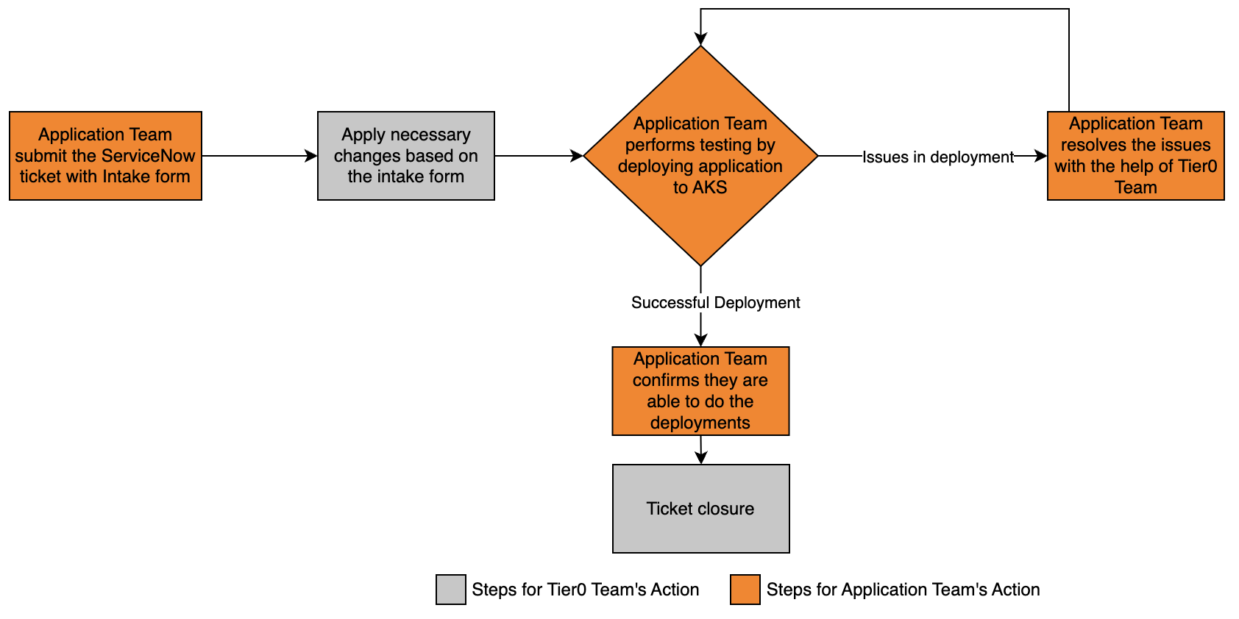
Tier0 Managed CAKS Intake
Timelines
SLA for Tier0 to execute the CAKS onboarding activities (excluding application team’s testing and deployments) | 2 weeks
Flow Explanation
Raise a ServiceNow ticket with CAKS Intake Form. Separate ticket is needed for each environment.
Tier0 team will apply the necessary changes based on the intake form.
Application team needs to perform complete testing for performing deployments
If there any issues, the application team need to get it resolved with the help of Tier0 team.
Once the application team provides positive confirmation over ticket for the deployments, the ticket will be closed.
Recommendation
To minimize the impact in ongoing activities, initial onboarding should be done in the least used environment.
We highly encourage the application team to submit the Perimeter Protection Intake form along with CAKS Intake form.

Slide 16
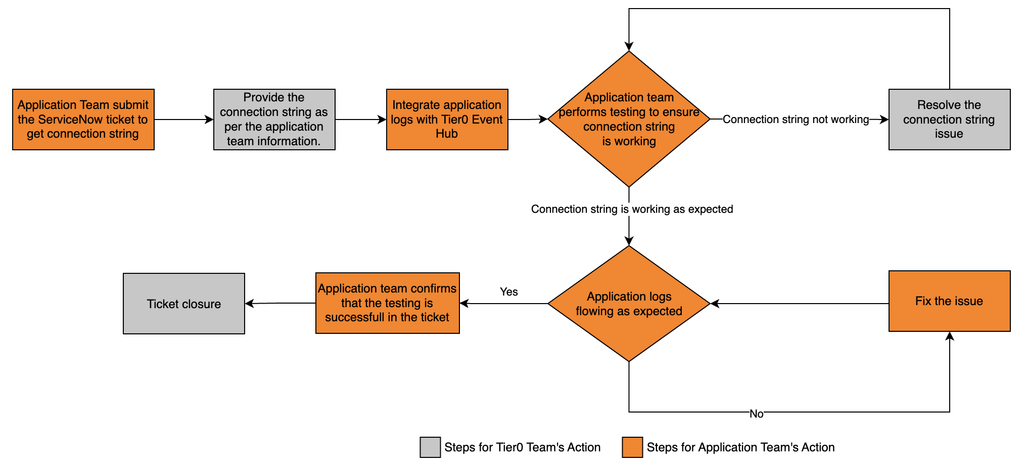
Application/VM Logs Integration
Flow Explanation
Raise a ServiceNow ticket to get connection string to be able to push application logs to Tier0 event Hub.
Tier0 team will provide the required connection string based on the information provided by application team
  Subscription name
  Environment name
  Application name
Application team will follow below links in sequence to integrate application logs with Tier0 EventHub.
Explore Dummy app
Explore Ness logging
Explore FluentD integration with AKS
Explore FluentD integration with VM
Application team need to perform complete testing to ensure that connection string is working, and application logs being pushed as expected.
Post successful connection in case of application logs not processing application team needs to fix the issue.
Once the application team provide positive confirmation over ticket for the testing, the ticket will be closed.
Raise a ServiceNow ticket in case assistance required from Tier0.

Slide 17








Overall Application Team Responsibilities
Persona
Raising ServiceNow request with onboarding form for provisioning of services (Centralized Logging, Policies & Sentinel).
DevOps
Raising ServiceNow request with intake form to setup Centralized AKS (Optional)
DevOps
Raising ServiceNow request with intake form to setup perimeter protection (Ingress).
DevOps & QA (for functionality validation)
Integration of application logs with Tier0.
DevOps & Dev
To fix all the non-compliant application resources w.r.t policies.
DevOps & Dev
Appropriate action to be taken based on sentinel and health alerts.
DevOps & Dev
Configuring and customizing the OpenIAM as per the application requirement.
DevOps & Dev
Fixing vulnerabilities/ security incidents on application resources.
DevOps & Dev

Slide 18
Support
How to engage with us.
Use the link https://optum.service-now.com/ to access ServiceNow for creating ticket.
Steps for Creating Service Now Ticket
Go to the Incident section in ServiceNow
  Select Create New
  Select the Type from these two only: Service Request, Request for Information
  Search and select the appropriate Assignment group
  Fill out the short description and description with as much detail as possible e.g., Subscription Name, RG name, Resource name, Steps to replicate etc.
  Attach relevant documents, screen shots, logs etc.
  Then save it.
Follow the link for more pictorial help.
Assignment Group Selection
OSGS Cloud Ops Support | SGS-Tier0-NonProd
Access related issues General operation issues OpenIAM issues | Application team onboarding Perimeter protection (Ingress) intake Application logs integration Technical issues e.g., application team not able to create resource due to Tier0 policy
NOTE :- Tier0 engineering team will not have access to production environment.

Slide 19
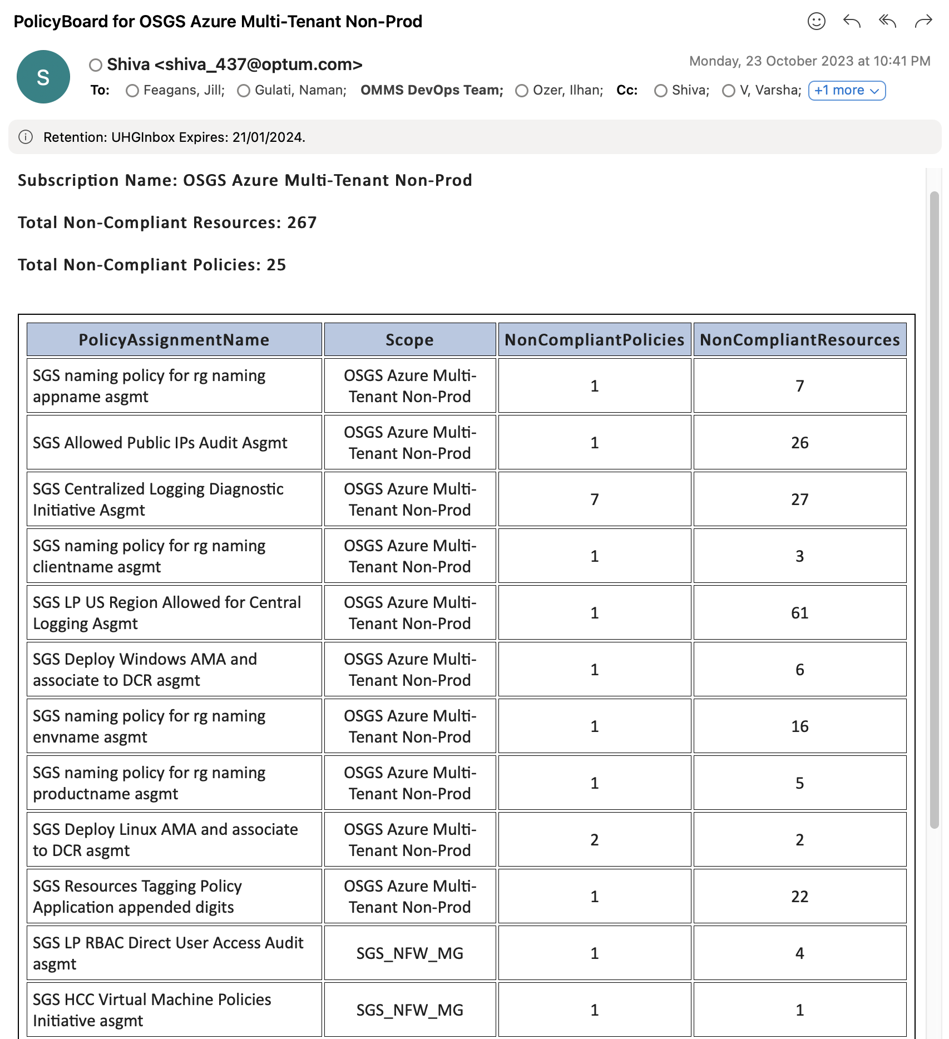
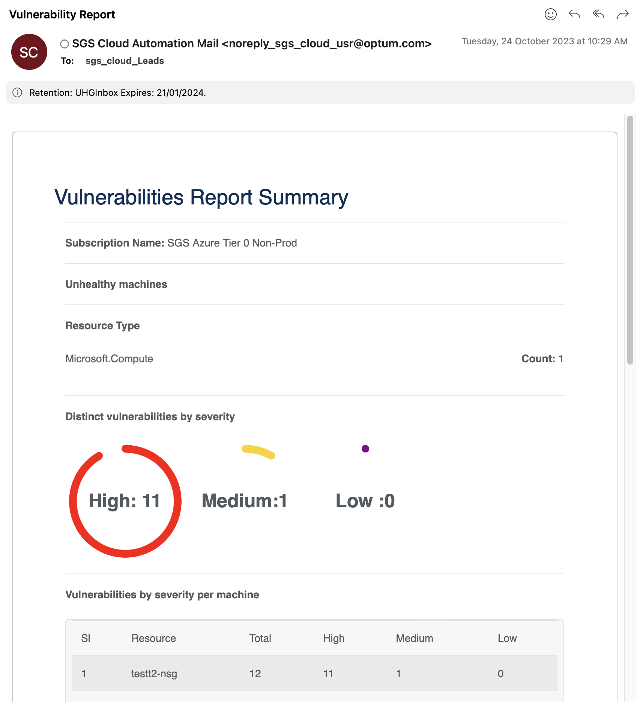
Policy & Vulnerability Email

Slide 20
Appendix

Slide 21
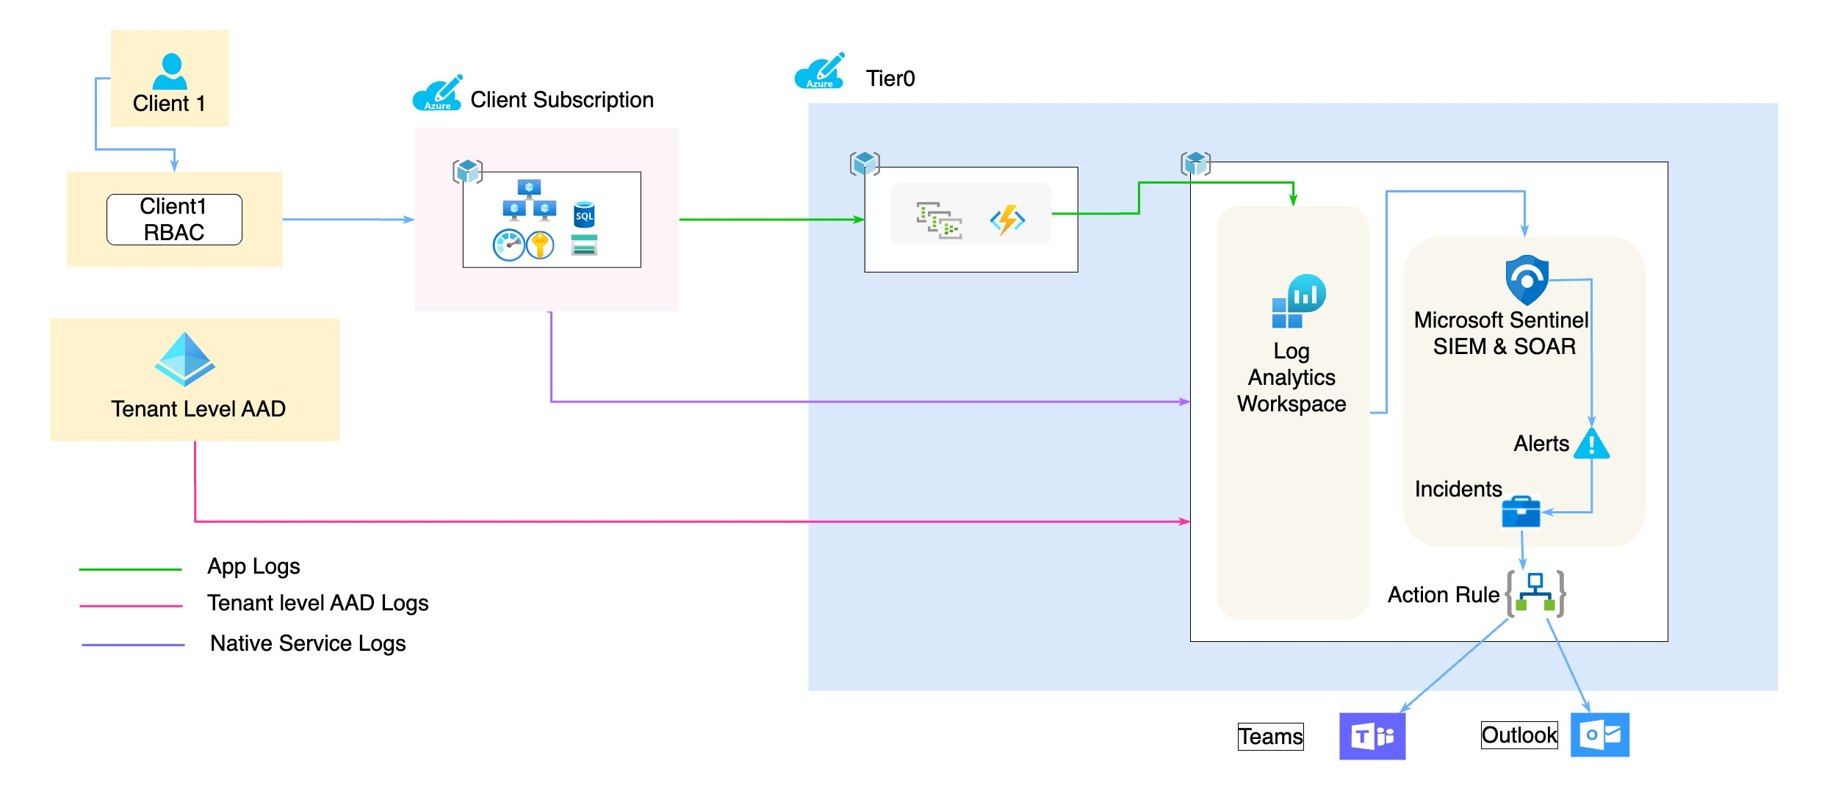
Centralized Logging (Launchpad)
Notes:
Native service logs : Defender logs, Netflow logs, VM logs, Diagnostic logs, Activity logs, AAD logs

Slide 22
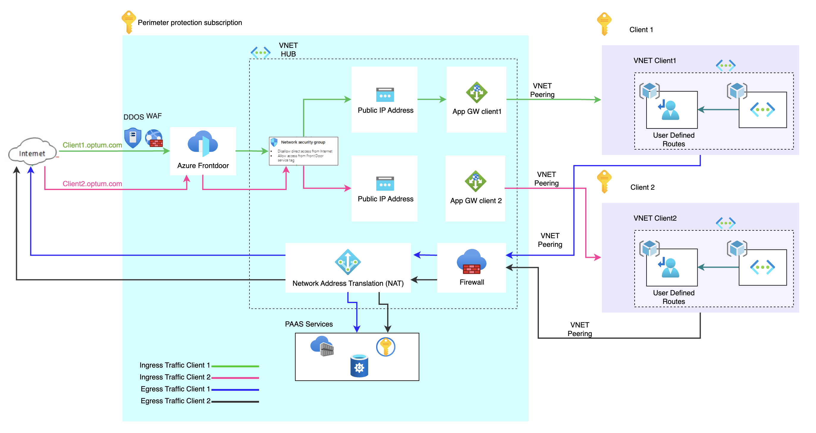
Perimeter Protection Architecture

Slide 23
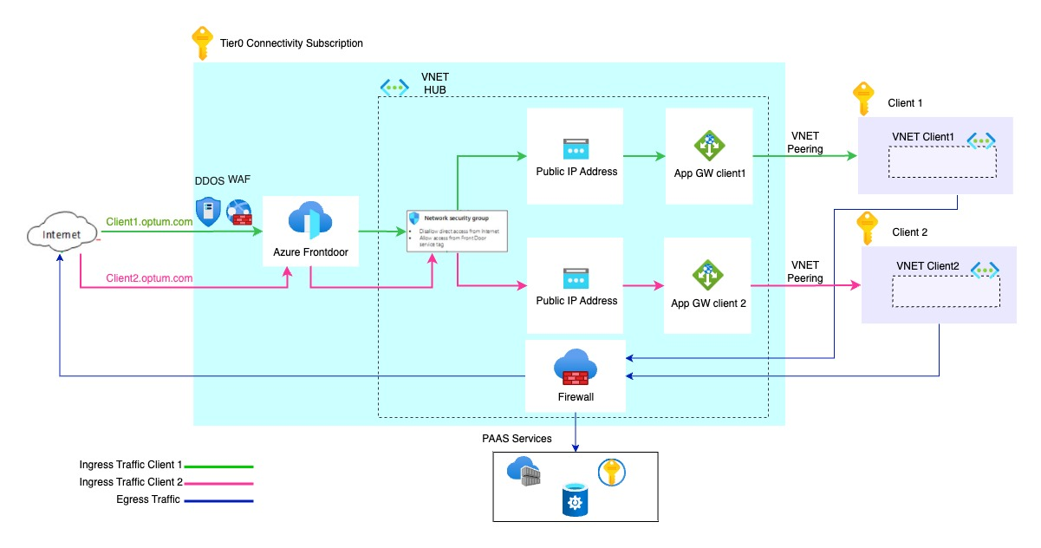
Perimeter Protection (Ingress)

Slide 24
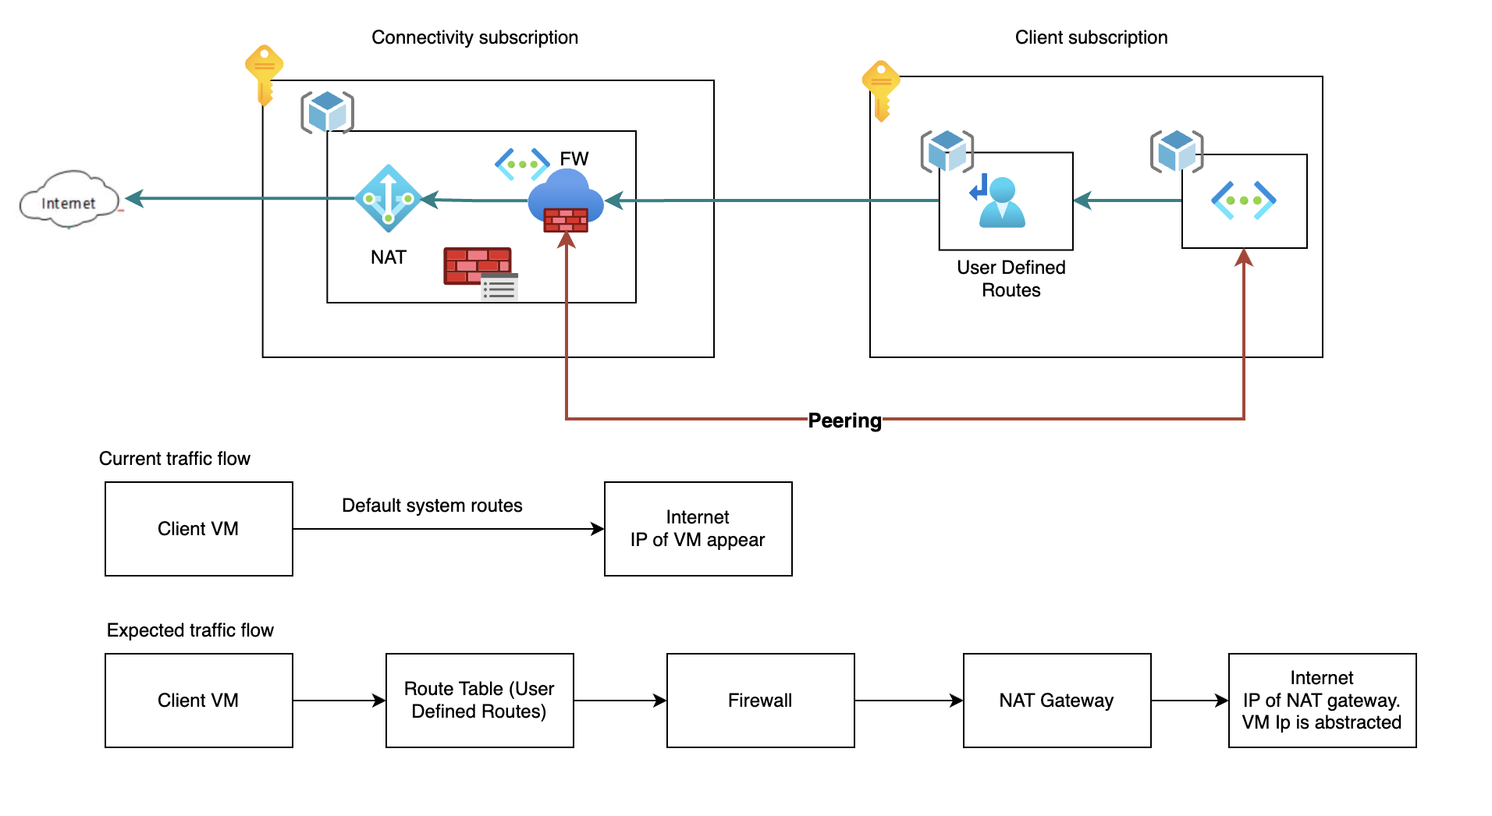
Perimeter Protection (Egress)

Slide 25
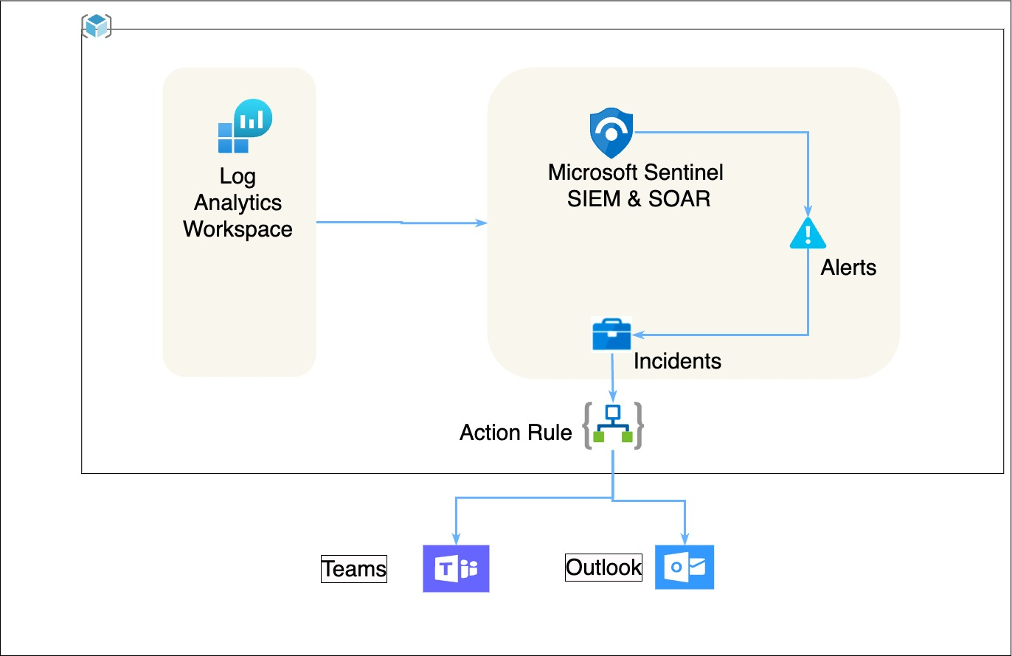
Sentinel
Notes:
Native service logs : Defender logs, Netflow logs, VM logs, Diagnostic logs, Activity logs, AAD logs

Slide 26
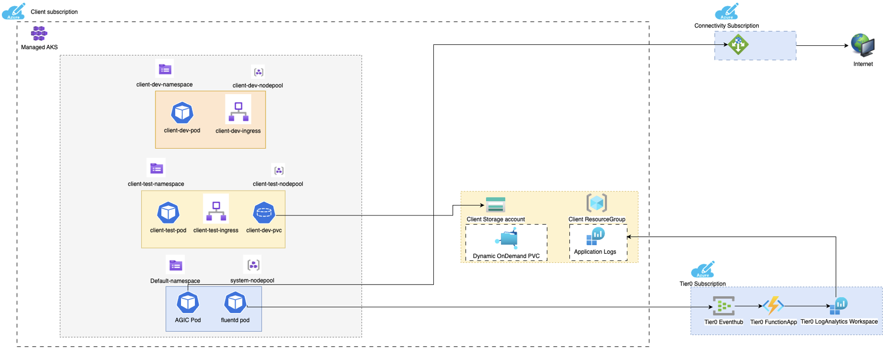
Tier0 Managed CAKS

Slide 27
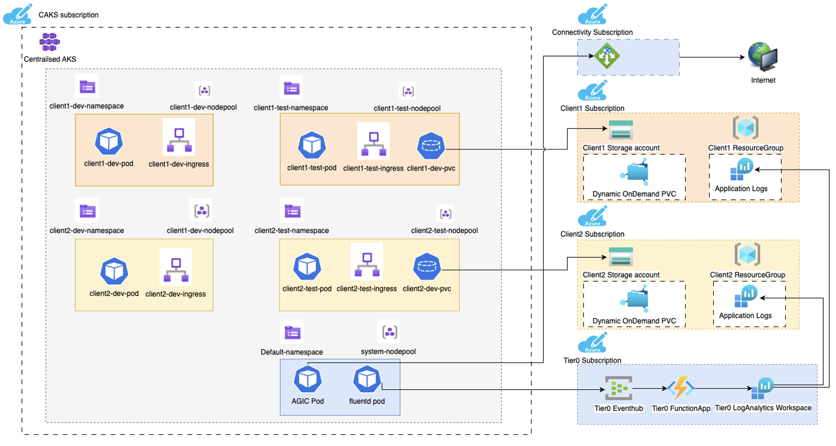
Tier0 Centralized AKS

